Slide 1
بسم هللا الرحمن الرحيم

Slide 2
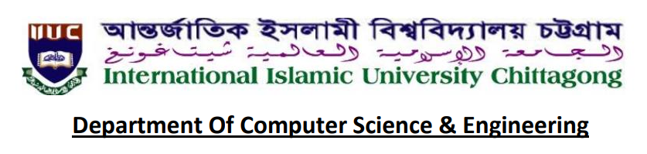
SOFTWARE DEVELOPMENT FINAL PROJECT BY Group 7
Course Name : Software Development 2
Course Code: CSE-3640
Course Teacher: Atia Binti Aziz
Adjunct faculty , Dept. Of CSE,IIUC

Slide 3
SOFTWARE DEVELOPMENT FINAL PROJECT BY Group 7
PROJECT NAME: Diamond Hotel Booking
TEAM NAME: Group-7
Section:6AF
Semester:6th
TEAM MEMBERS:
C193209_Sahana Akter
C193214_ Samira Saimee
C193221_Lubna Sultana

Slide 4
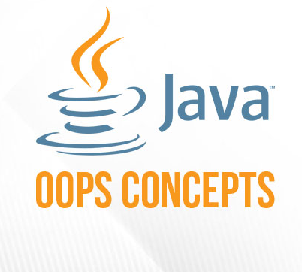


Tools:
Intelli J IDEA.
Java OOP
Data Storing in File

Slide 5
Introduction:
The project, Hotel Booking System that allows the hotel manager to handle all hotel activities. The Purpose of the whole process is to ease the daily or regular activities of the Hotel Booking process. The daily activities includes the Room activities, Entering name of the new customer check in, To allocate a room as per the customer need and interest, and also view all rooms ,delete customer etc

Slide 6
Objectives:
Main objective of this project is to provide solution for hotel to manage most there work using computerized process.
This is help admin to handle customer , room allocation details, view rooms etc.
Keeping records of customers. ·

Slide 7
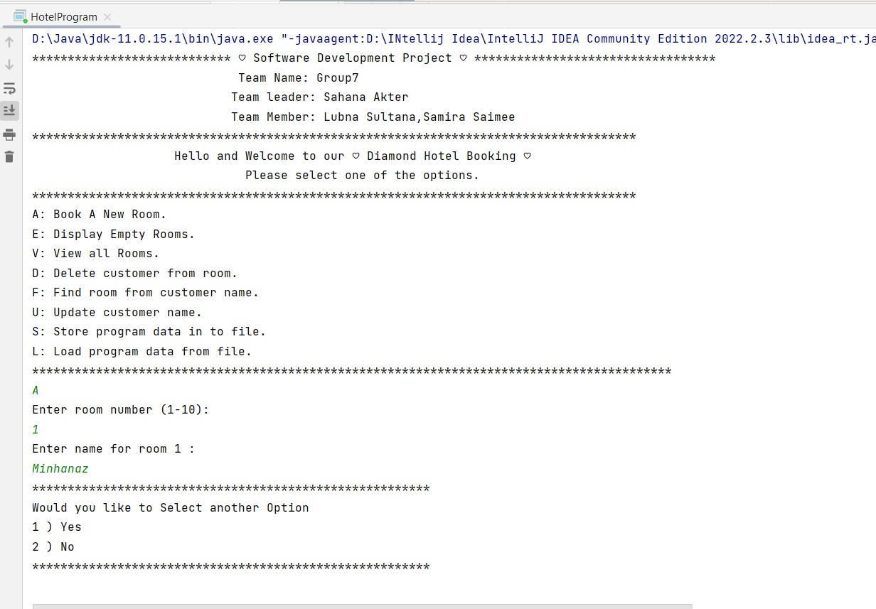
Welcome to our project 1) Book A New Room!

Slide 8
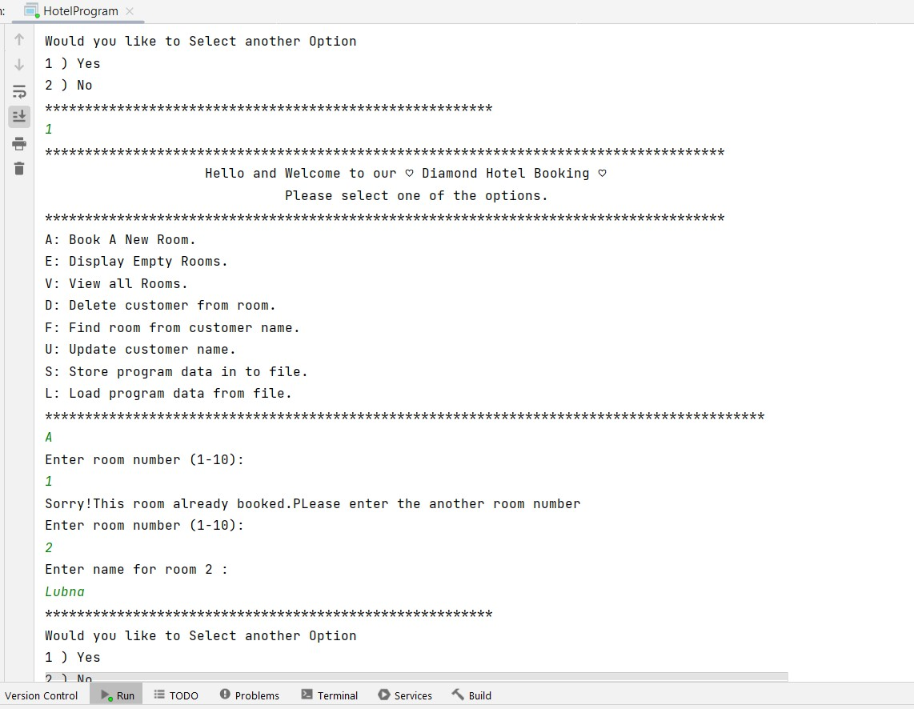
If same room book then it will message sent this -> already room booked.
This message show

Slide 9
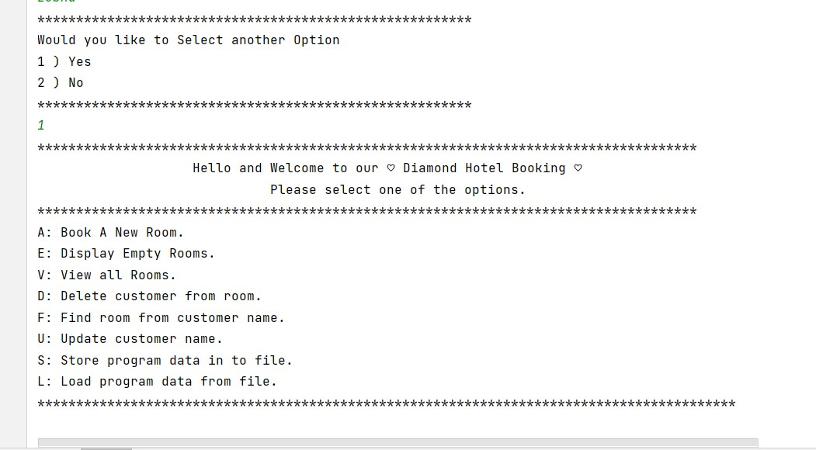
If we are continue

Slide 10
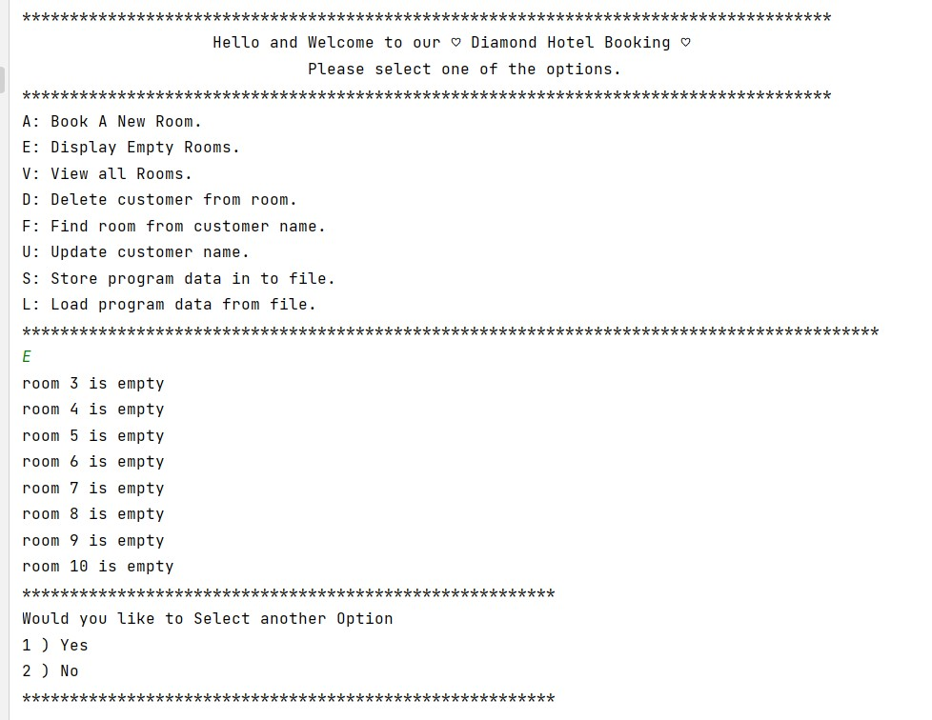
2) Display Empty Rooms.
This empty room show

Slide 11
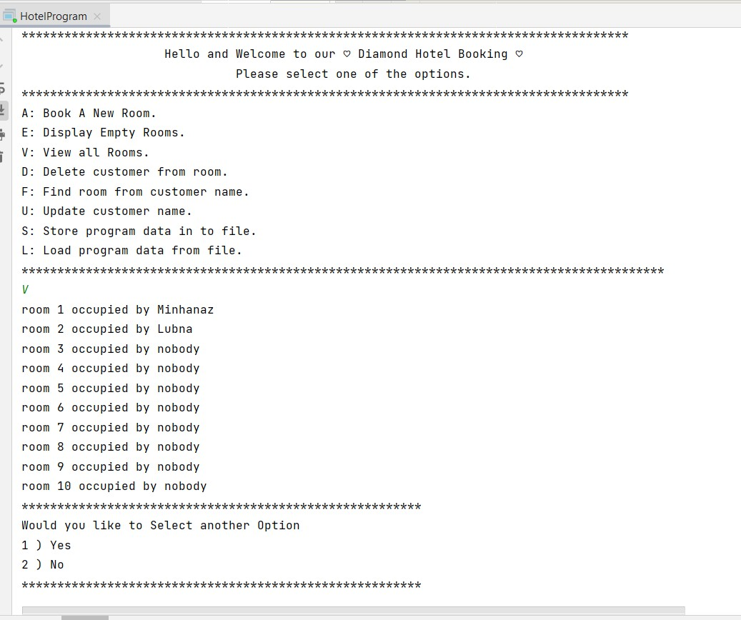
3) View all Rooms.
This all room show

Slide 12
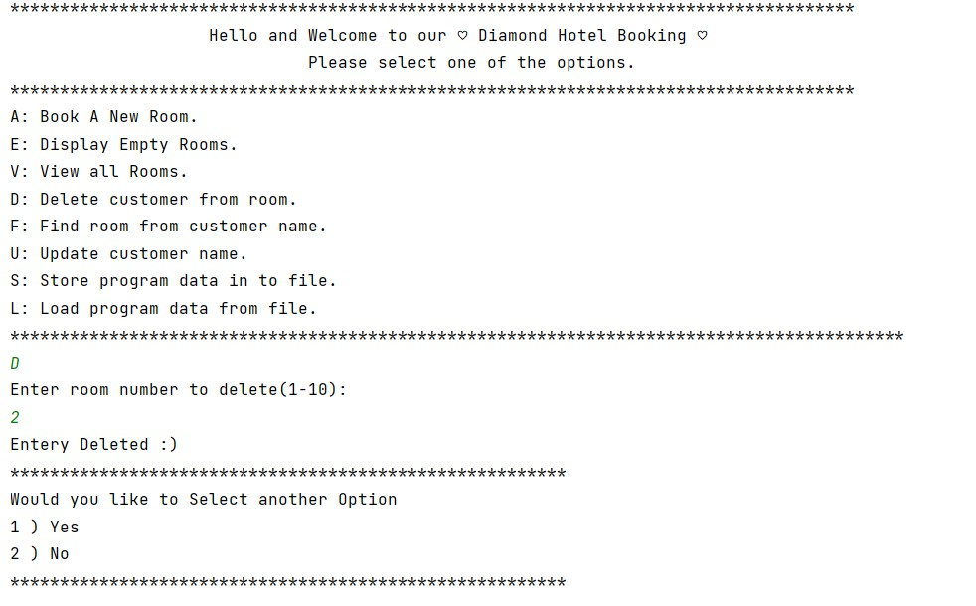
4) Delete customer from room.

Slide 13
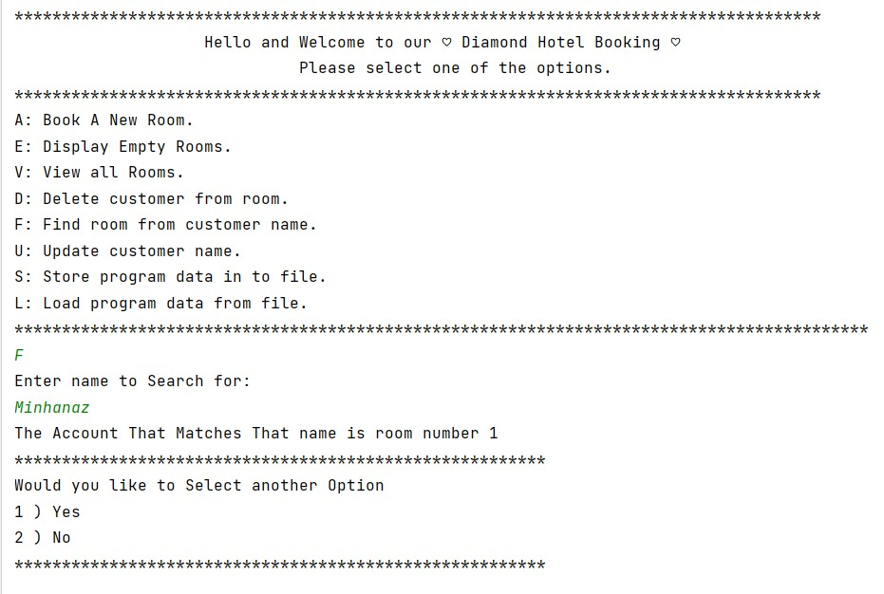
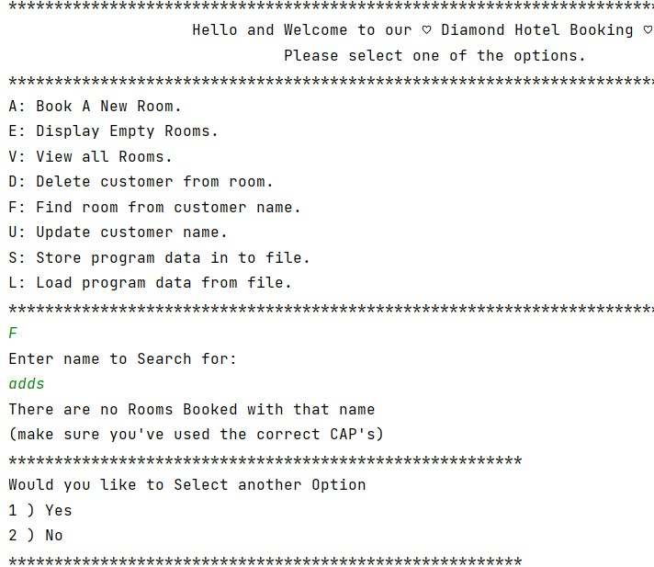
5) Find room from customer name.

Slide 14
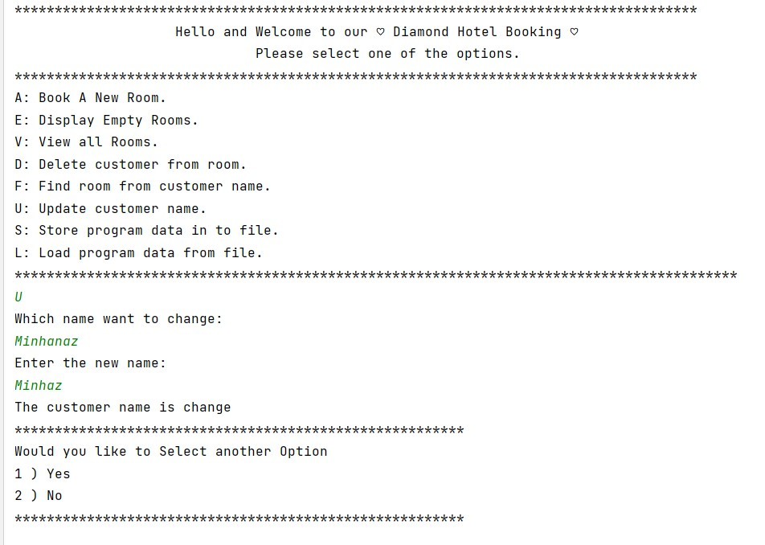
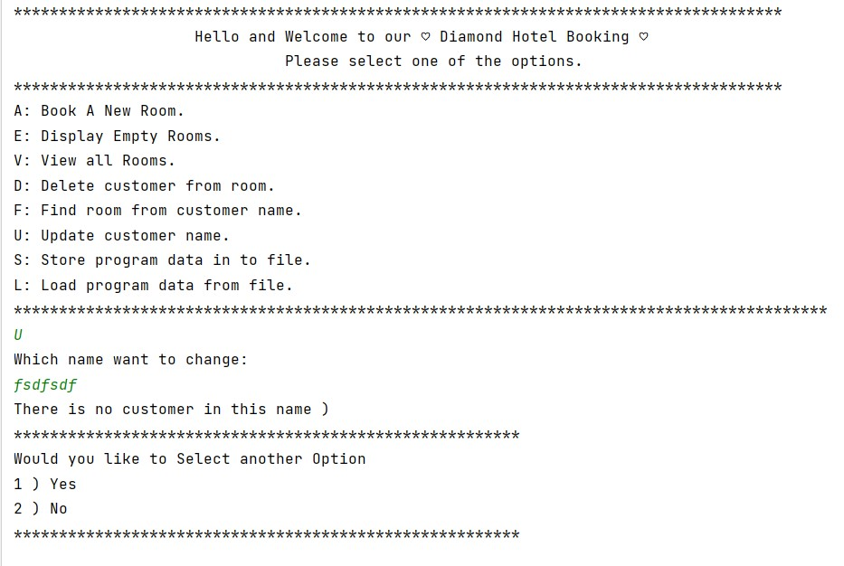
6) Update customer name.

Slide 15
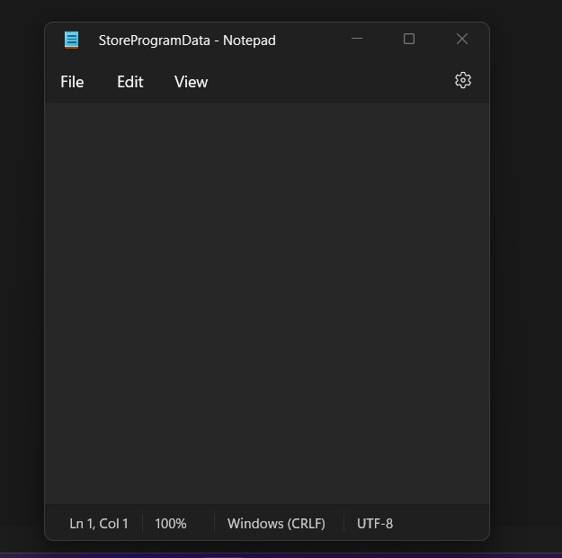
7) Store program data in to file.
If we want all information save in a file.
1st we create a empty file
File is empty

Slide 16
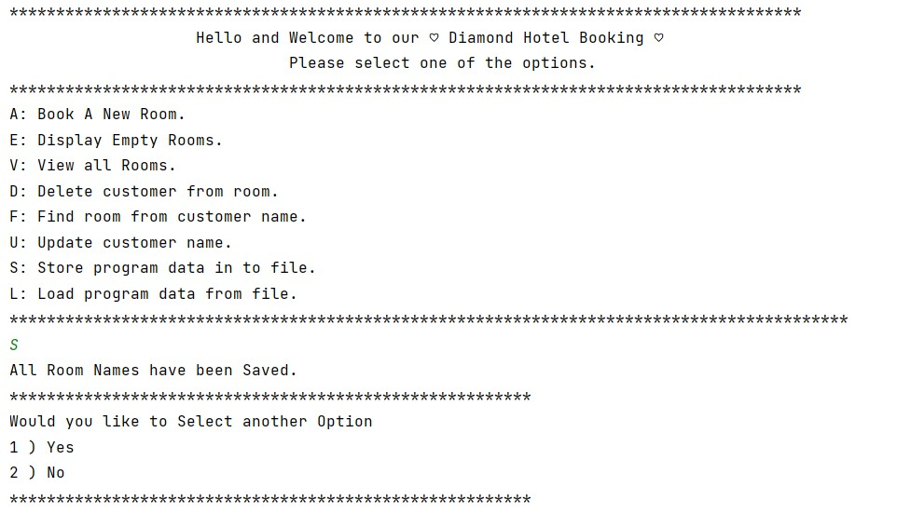
Then we save all the information

Slide 17
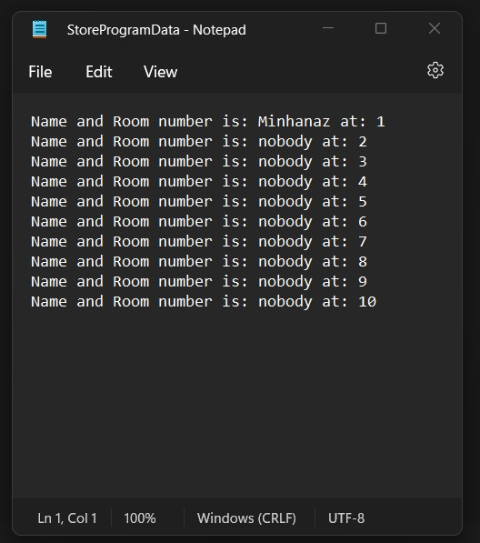
Then we see all the information save on a File.

Slide 18
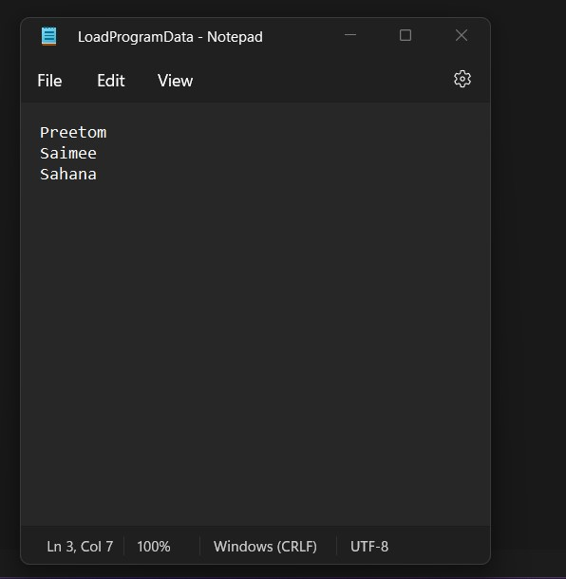
8) Load program data from file.
If we want input from the file.
1st we create a empty file.
Then give some input.

Slide 19
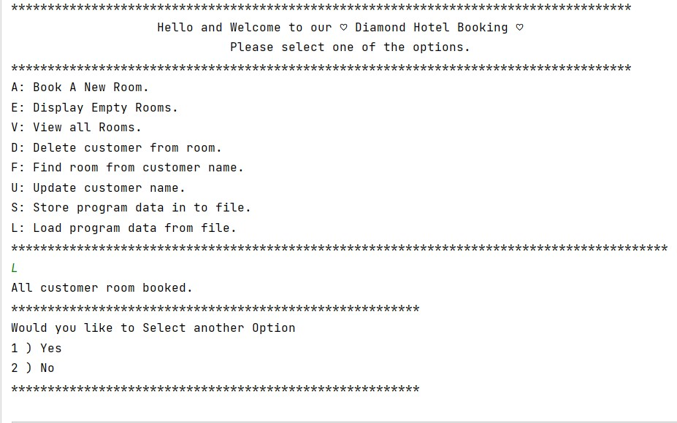
Then we input the data from the file

Slide 20
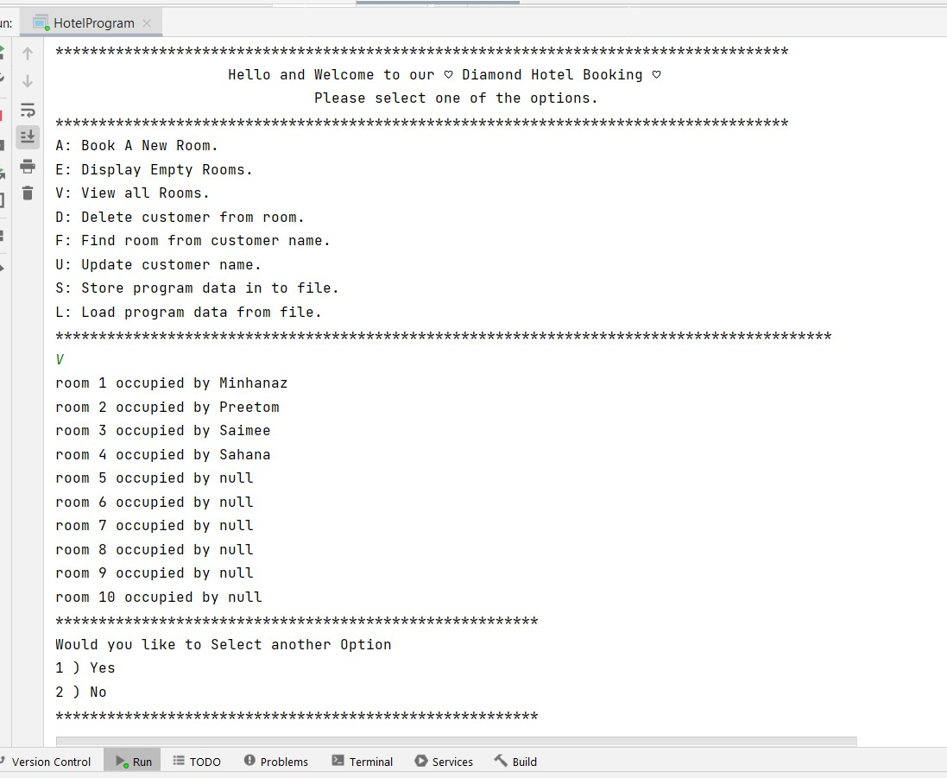
Now we can see that view rooms.

Slide 21
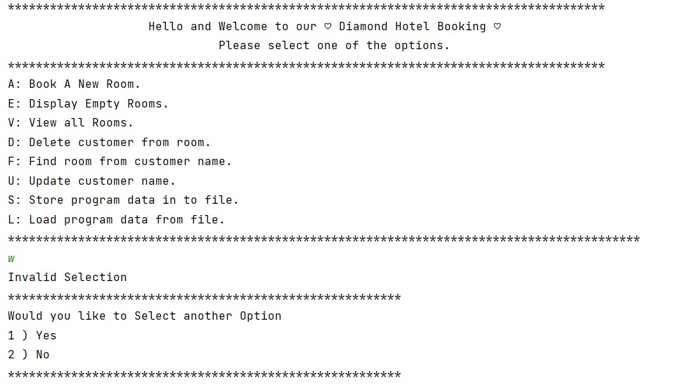
9)If we choice another invalid option.

Slide 22
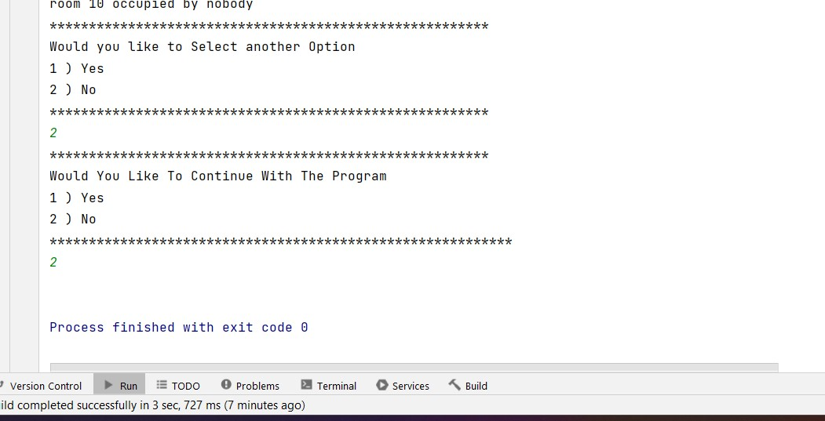
Option select

Slide 23
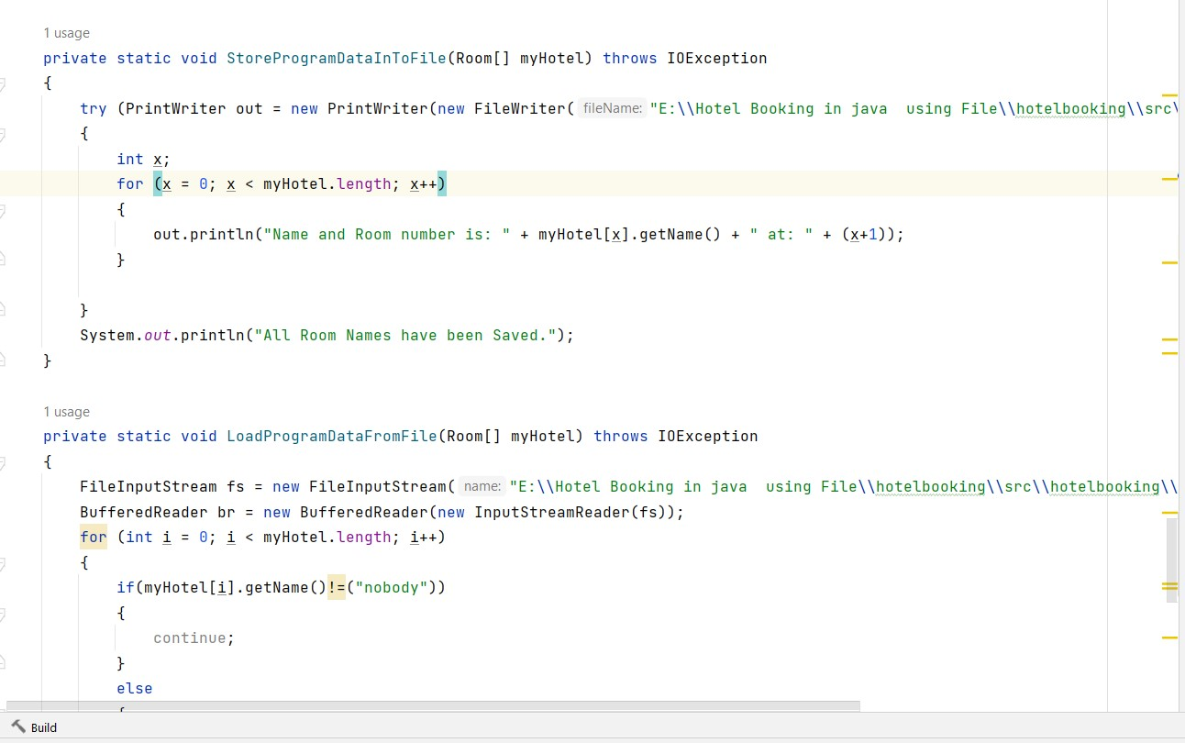
Error Handling
We use error handling in this here->

Slide 24
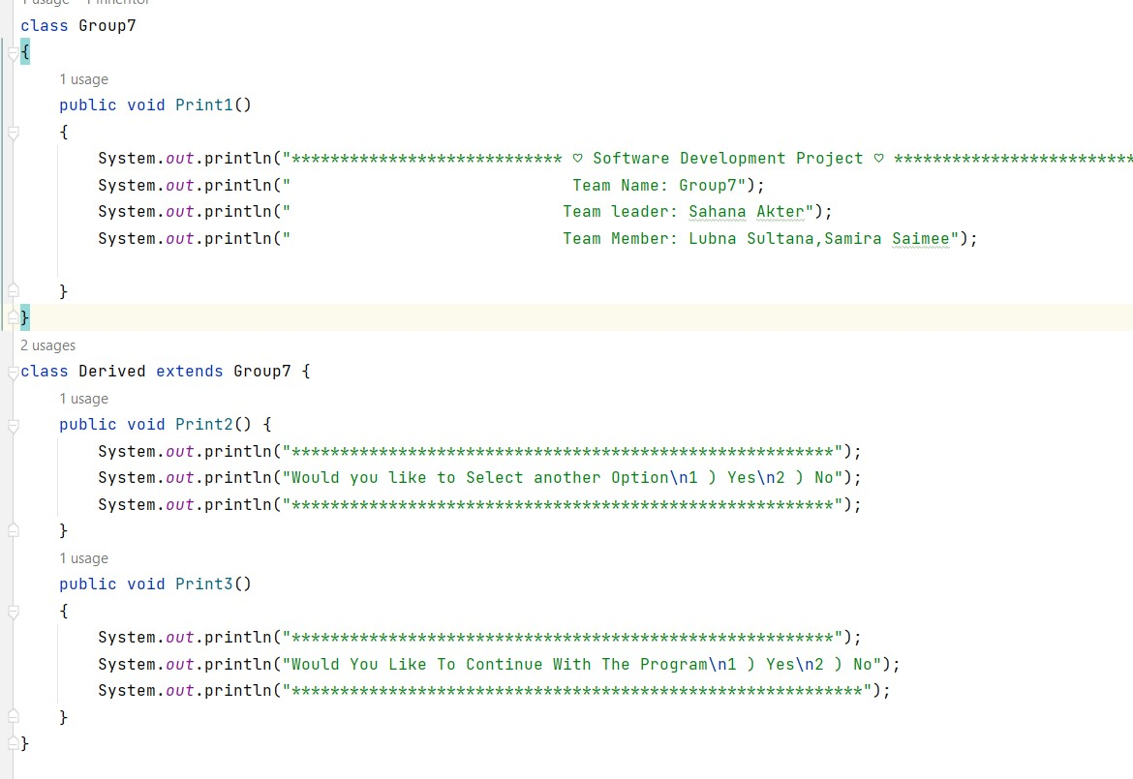
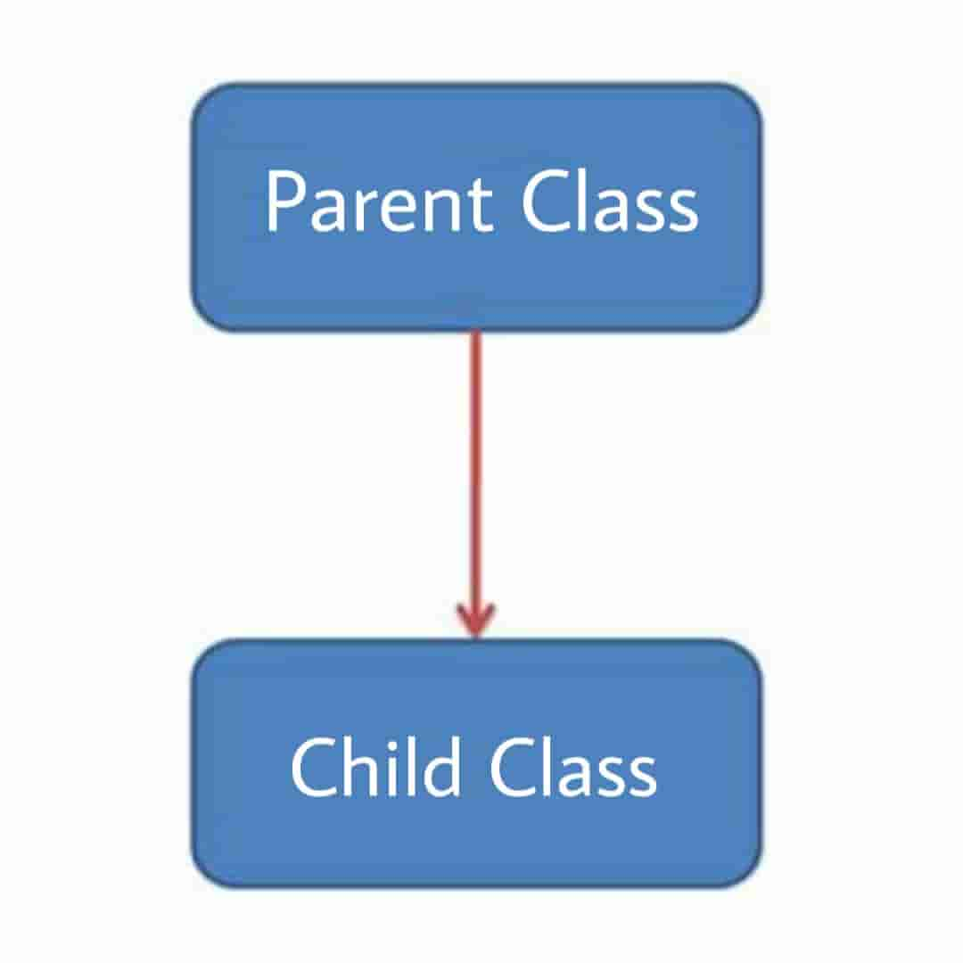
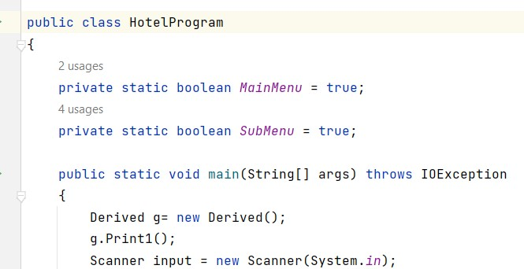
OOP Implementation
We use here Inheritance ->
Inheritance in Java is a concept that acquires the properties from one class to other classes;
Parent
Child

Slide 25
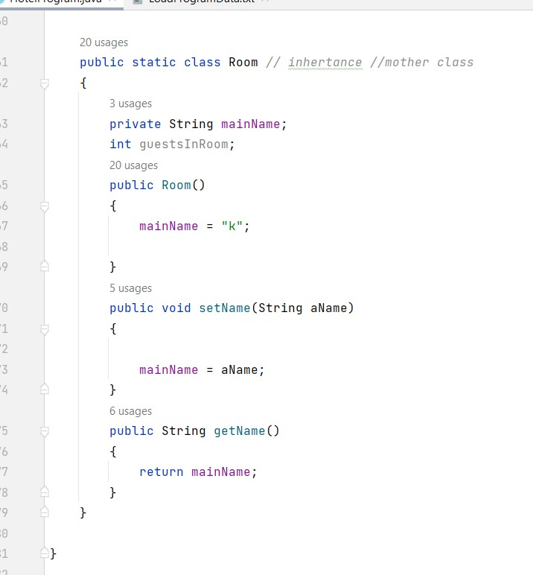
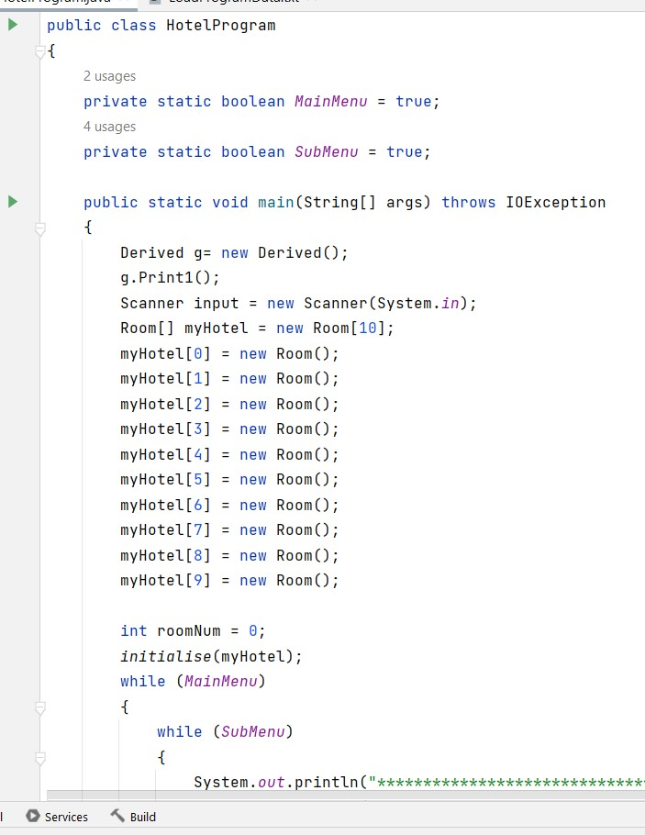
We use another Inheritance ->
Child
Parent

Slide 26
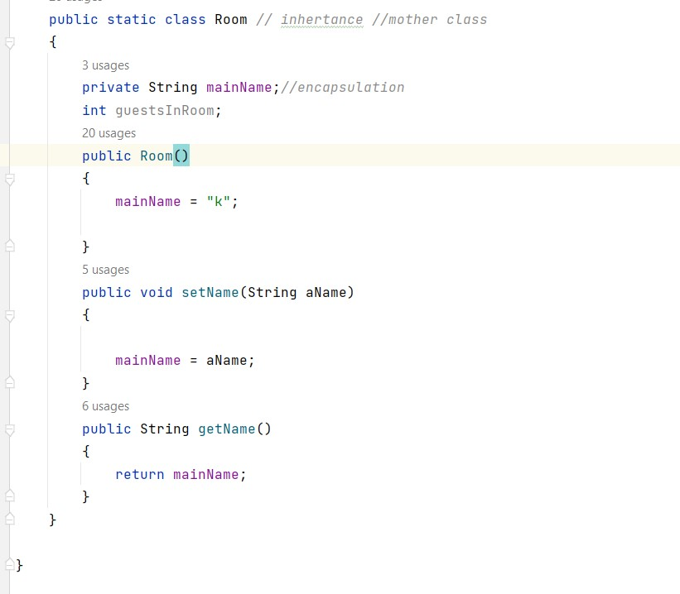
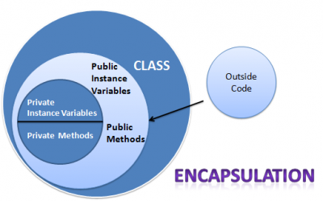
We use here Encapsulation ->
Encapsulation is one of the key features of object-oriented programming. It involves the bundling of data members and functions inside a single class.
Bundling similar data members and functions inside a class together also helps in data hiding.

Slide 27
Limitation
We can’t add customer more information.
We have no employee information
Future Plan
To convert this project in app then we can use it by laptop , desktop and mobile Add restaurant option in our project.
Add also driver.
Add review option for the customer.

Slide 28
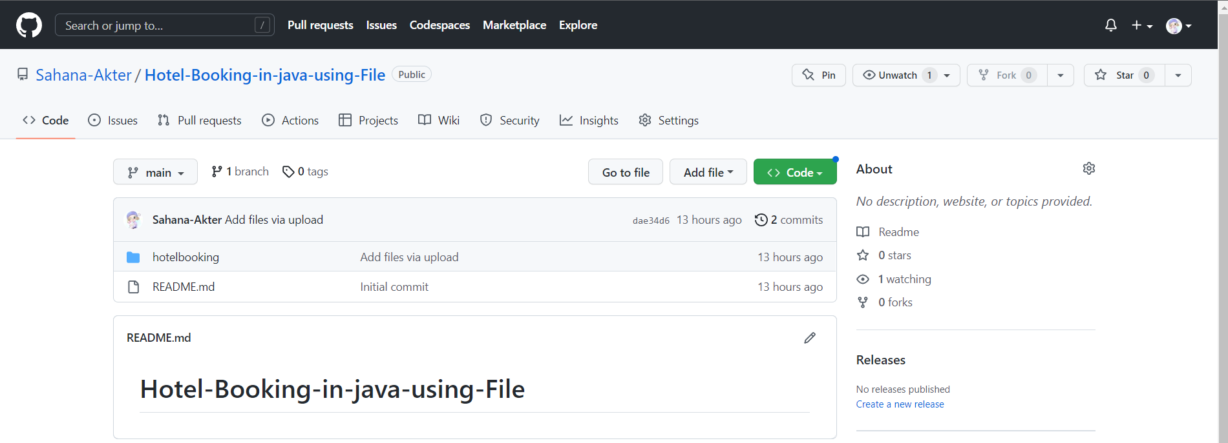
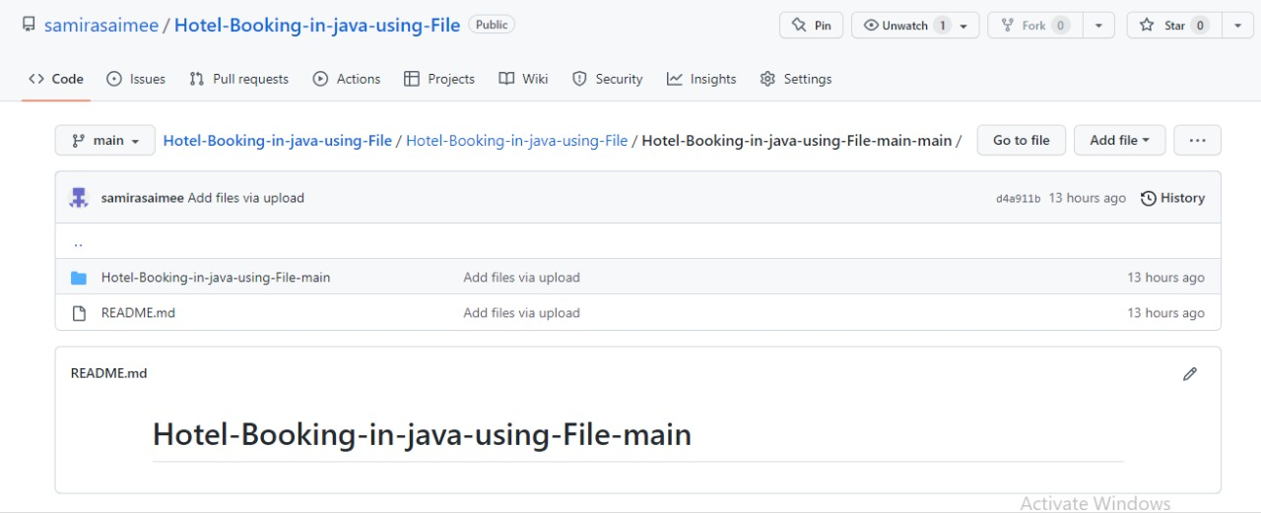
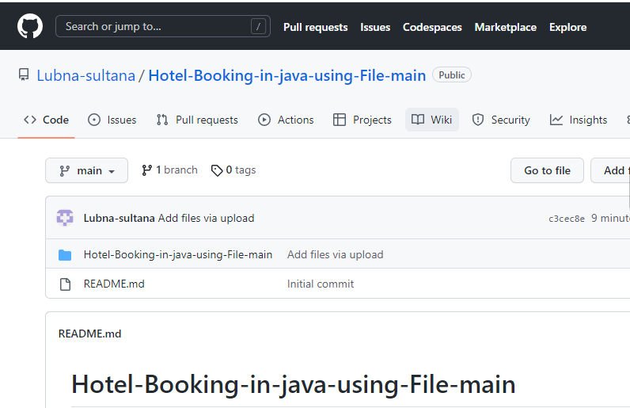
Github link of our project(Individually)
C193209(Sahana Akter):https://github.com/Sahana-Akter/Hotel-Booking-in-java-using-File.git
C193214(Samira Saimee): https://github.com/samirasaimee/Hotel-Booking-in-java-using-File/tree/main/Hotel-Booking-in-java-using-File/Hotel-Booking-in-java-using-File-main-main
C193221(Lubna Sultana): https://github.com/Lubna-sultana/Hotel-Booking-in-java-using-File-main.git
Sahana Akter Samira Saimee Lubna Sultana

Slide 29
THANK YOU
HOPE YOU LIKED OUR PROJECT

